Slide 1
GIMP Tutorial

Slide 2
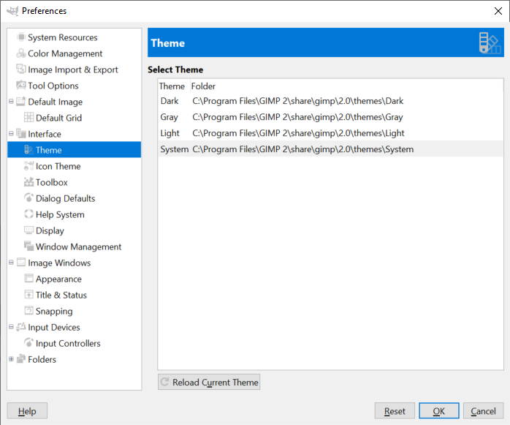
Open GIMP and set Preferences
Edit
Preferences
Theme
System

Slide 3
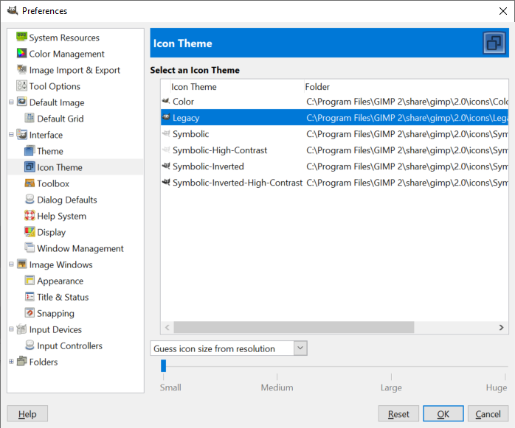
Preference – Icon Theme

Slide 4
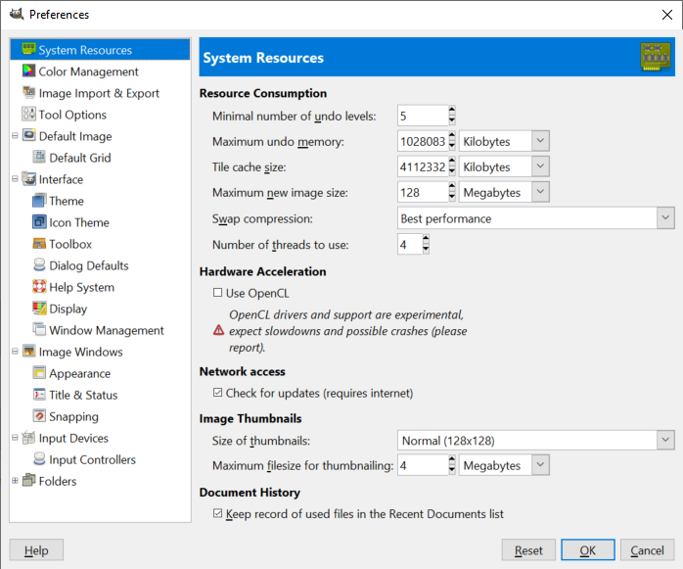
System Resources Overview

Slide 5
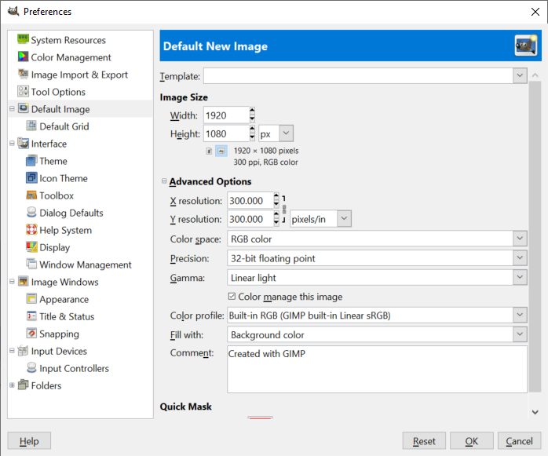
Set a Default Image Size

Slide 6
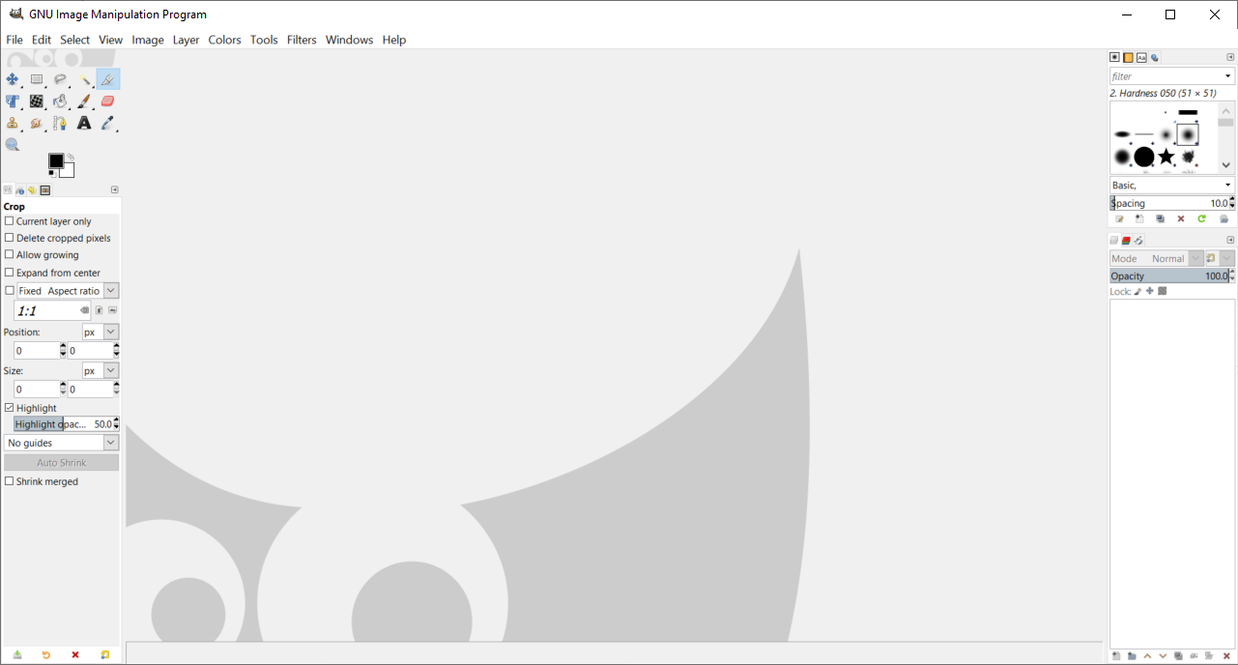
GIMP Layout – 5 Main Areas

Slide 7
Main Areas
Tool Box
Tool Options
Images Window
Layers / Channels / Undo History / Paths
Bush / Patterns / Gradians

Slide 8
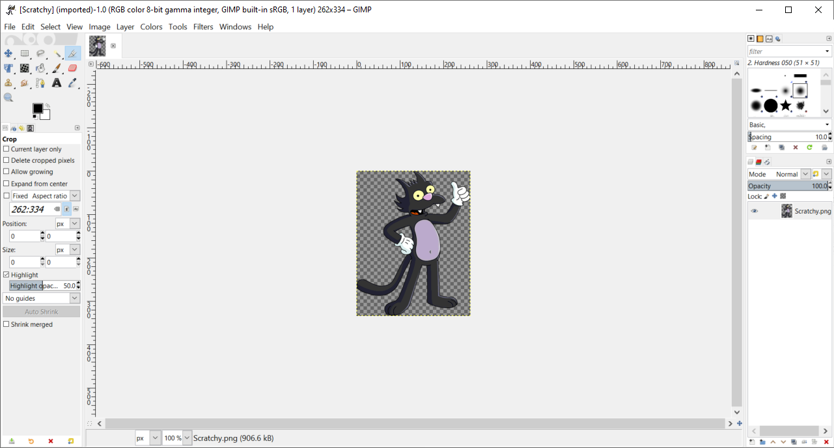
Open a file – Use Scratchy
Windows Explorer
Right Click
Open with – GIMP

Slide 9
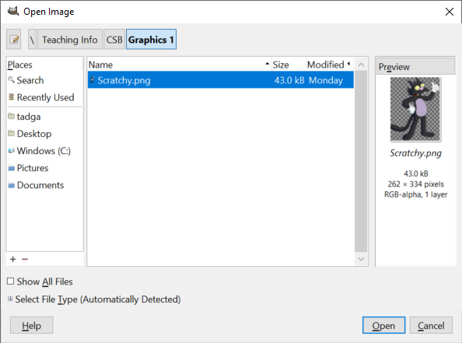
You may also use the GIMP Explorer to opn

Slide 10
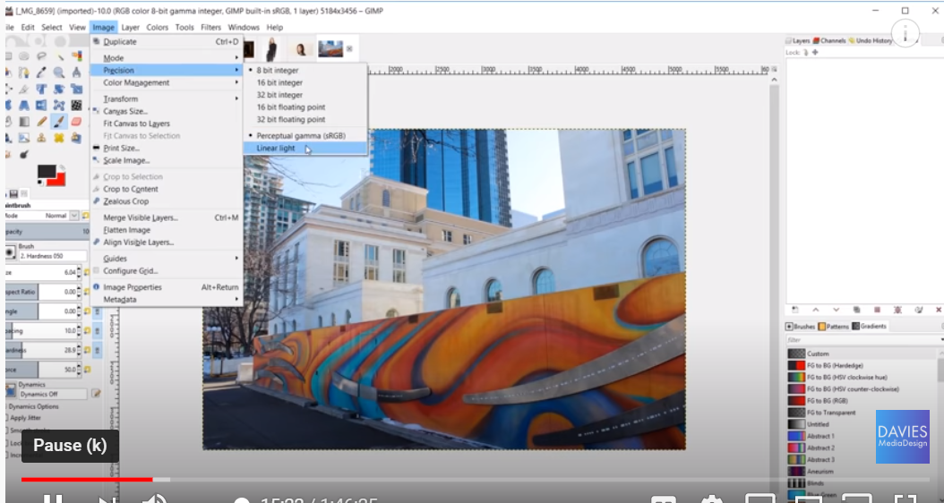
Change Image Resoution

Slide 11
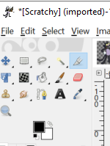
This is your Toolbox
Your Tool Box can be customized. Edit > Preferences > Interface > Toolbox

Slide 12
Tools are uses for:
Image Editing
Drawing
Creating Selection Area
Manipulating Areas of an Image
Moving and Distorting Objects
Adding Text
Coloring Areas and Text
Plus many other things!
Note: GIMP is free, but it is a very powerful tool!

Slide 13
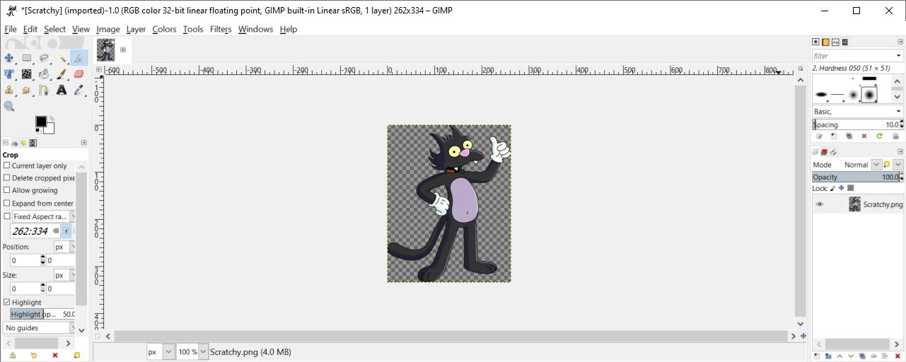
Rulers – Units can be changed

Slide 14

Change Zoom and Birds Eye View

Slide 15
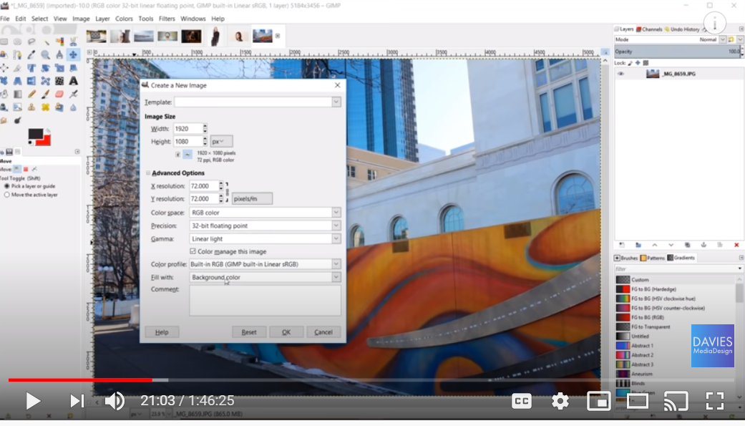
Create a New -> File > New (change your background colors - if needed)

Slide 16
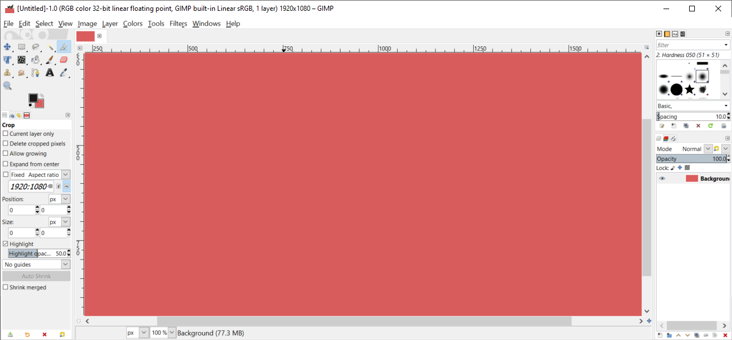
Should look like this:

Slide 17
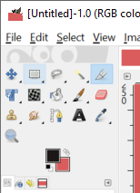
Overview of Each Tool
Rectangle Select Tool
Replace current Selection Mode
Add to current Selection
Subtract from current Section
Intersect with current Selection
These basically are for isolating objects in a composition

Slide 18
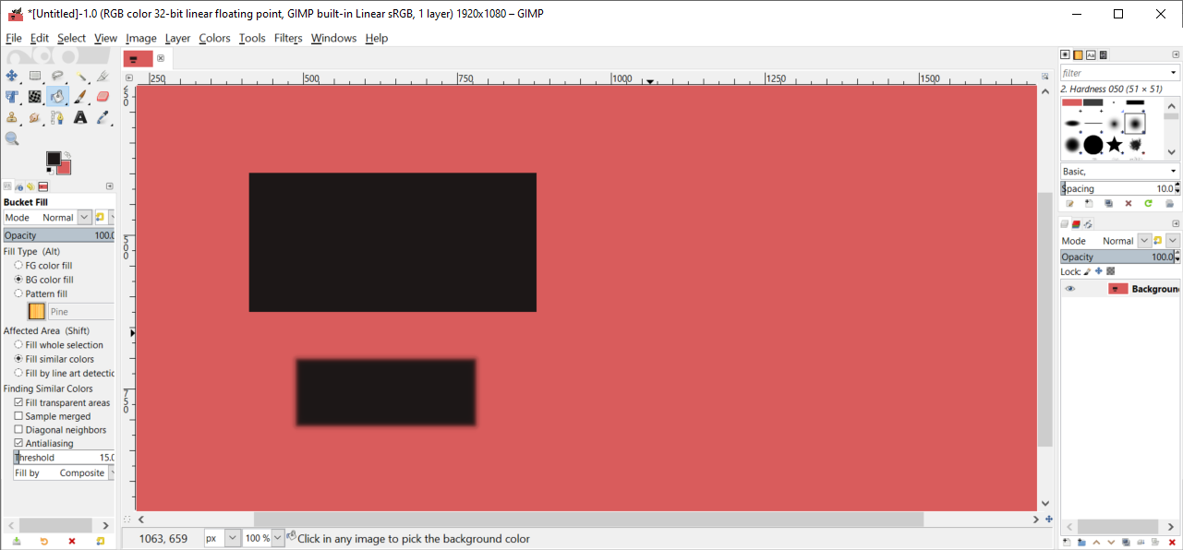
Select fill and feather edges - practice

Slide 19
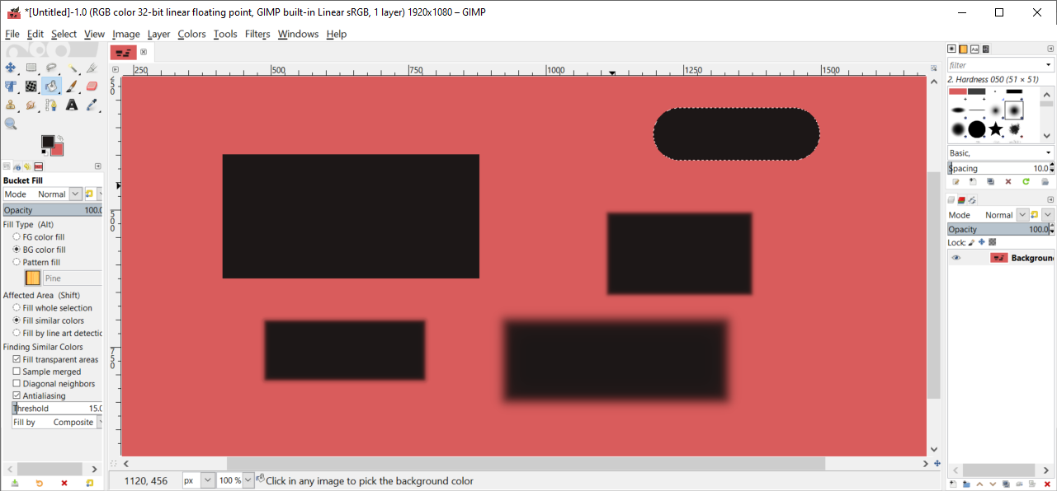
Round your corners – Test it out

Slide 20
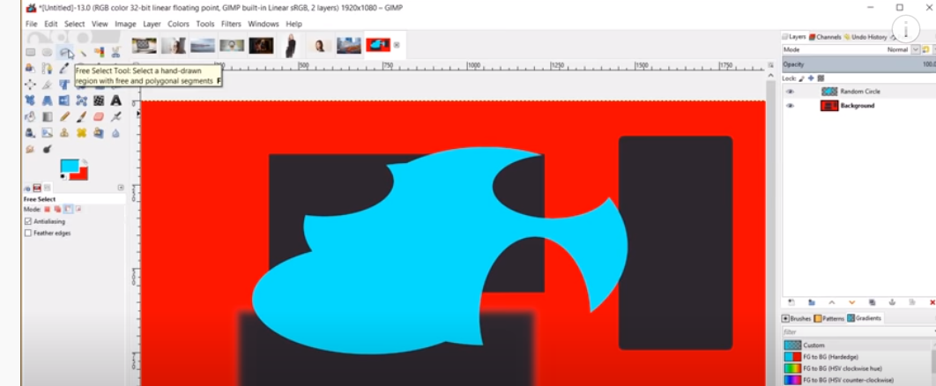
The Free Select Tool – used to free hand a selection shape

Slide 21
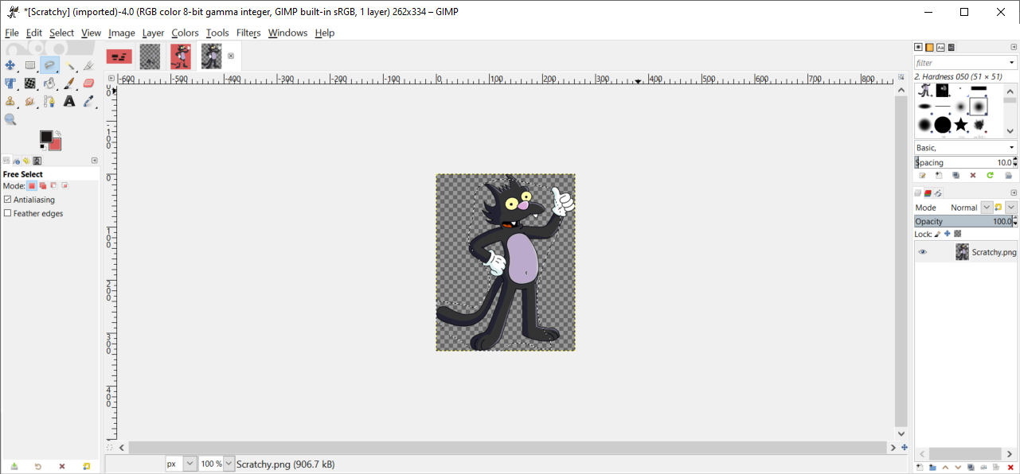
Draw around Scratchy then hit enter

Slide 22
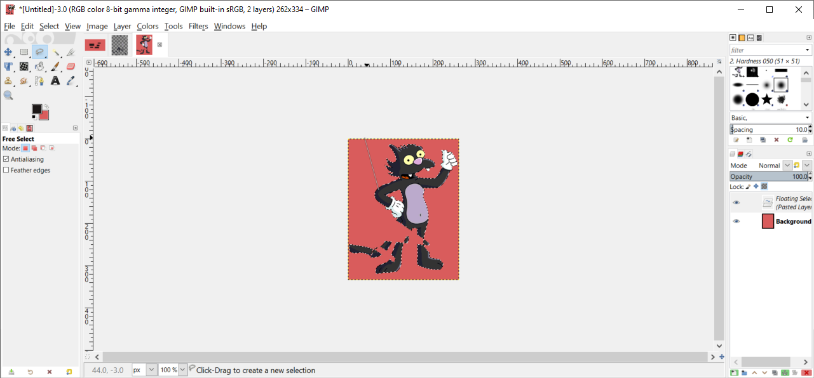
Copy to a new image – with paste

Slide 23
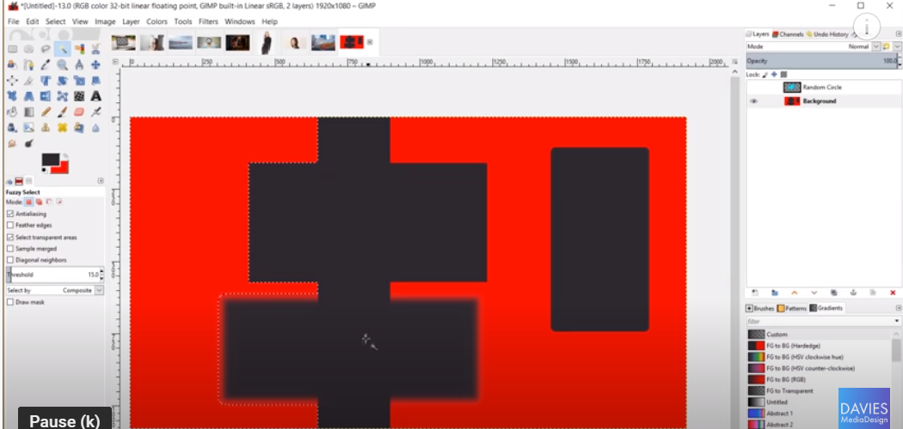
Fuzzy Select Tool – selects anything the same color

Slide 24
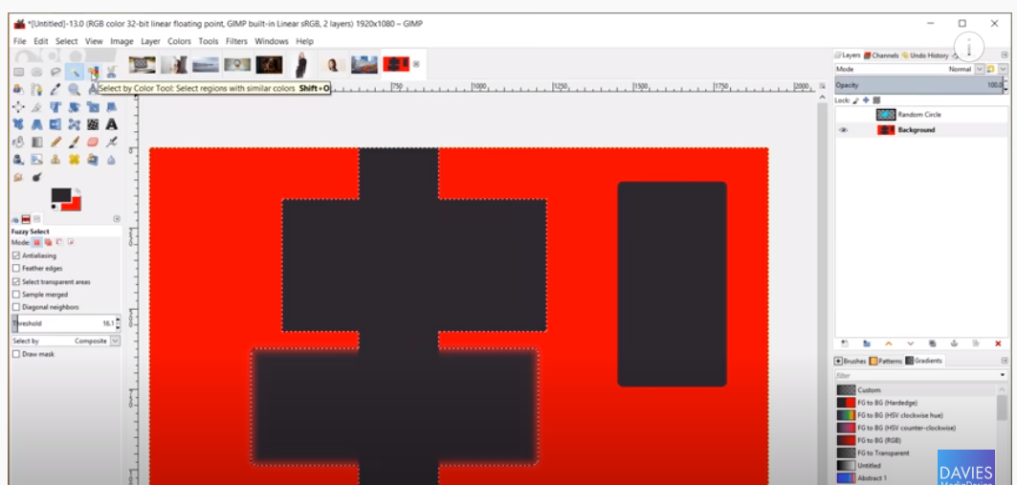
Select by Color Tool – selects all the red (This is great for photographs )

Slide 25
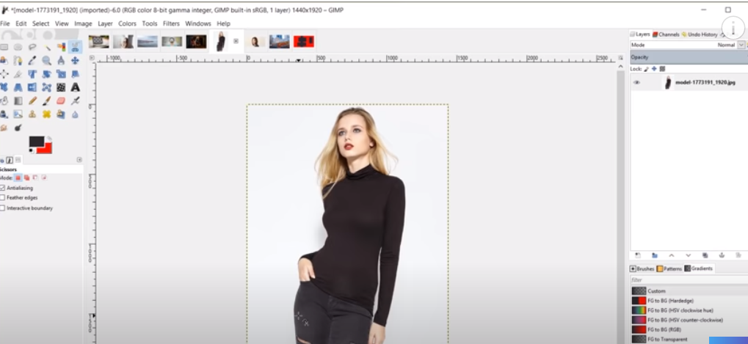
Intelligence Scissors Tool – snaps a line around an object (not that great)

Slide 26
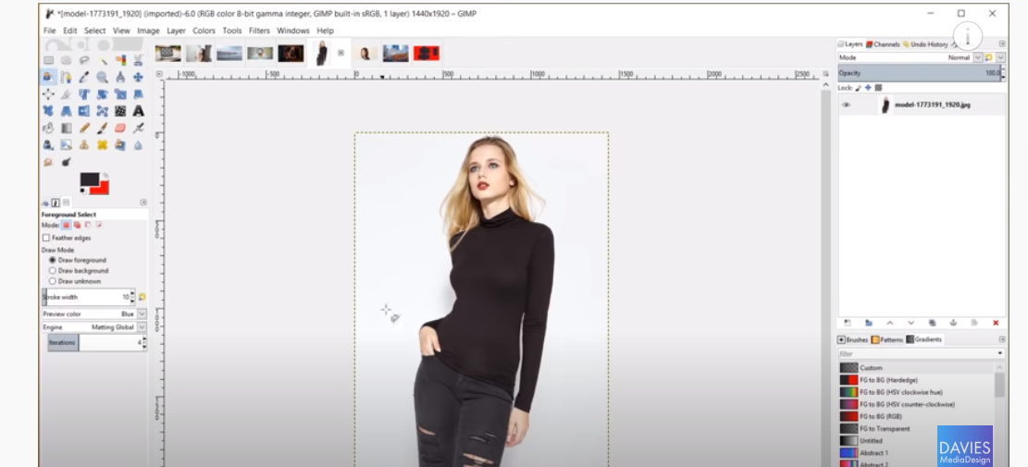
Foreground Select Tool – only works with high contrast

Slide 27
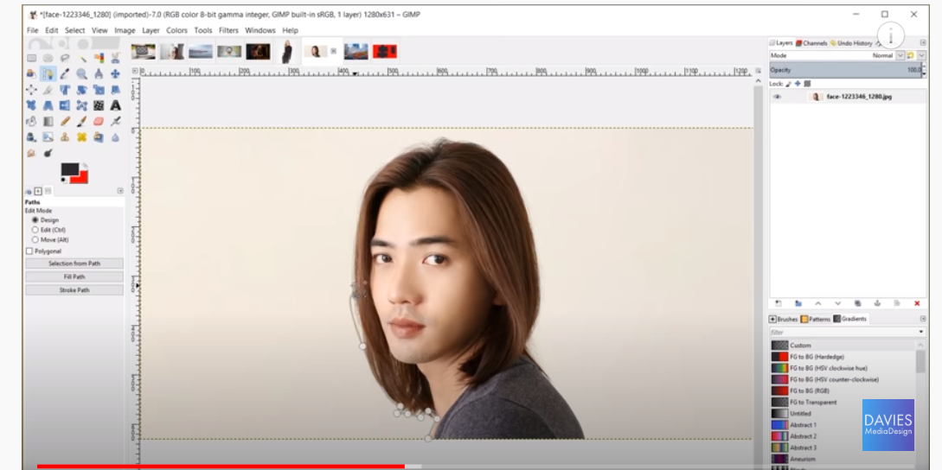
Paths Tool – Good for erasing backgrounds

Slide 28
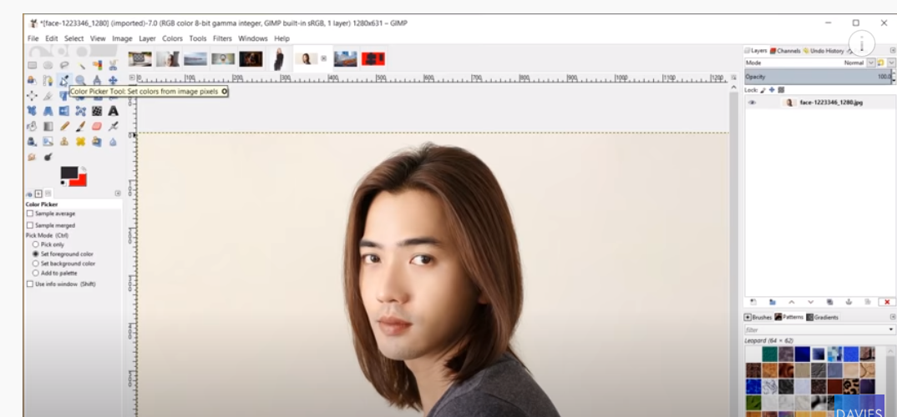
Eye Dropper or Color Picker – pick a color

Slide 29
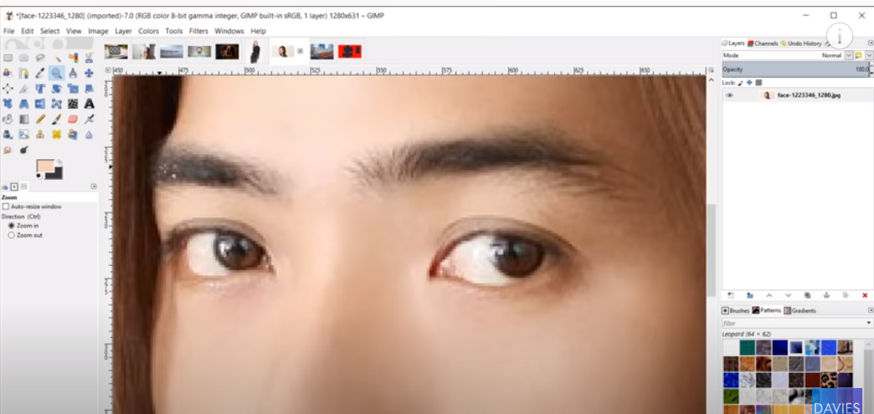
Zoom Tool – zooms in

Slide 30
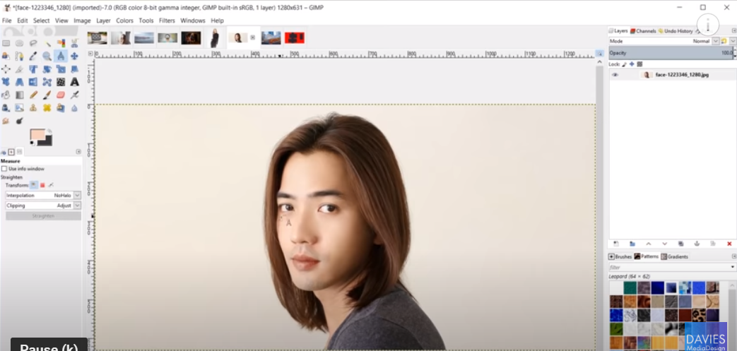
Measure Tool – measures distance between objects

Slide 31
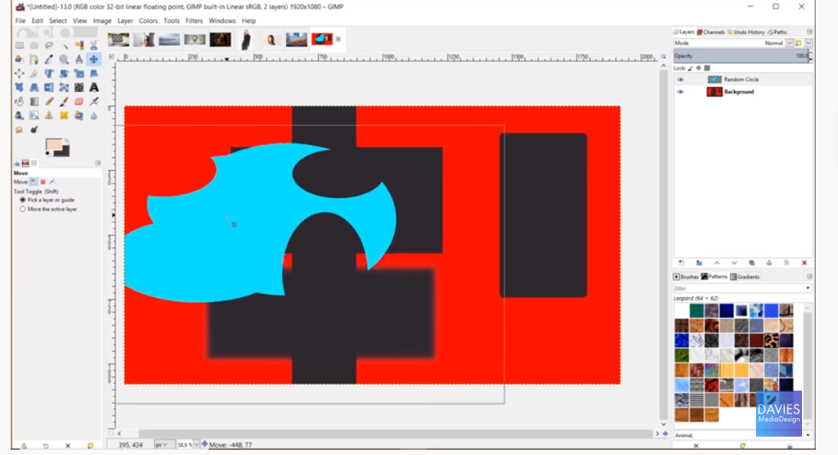
Move Tool – Moves any object on a layer

Slide 32
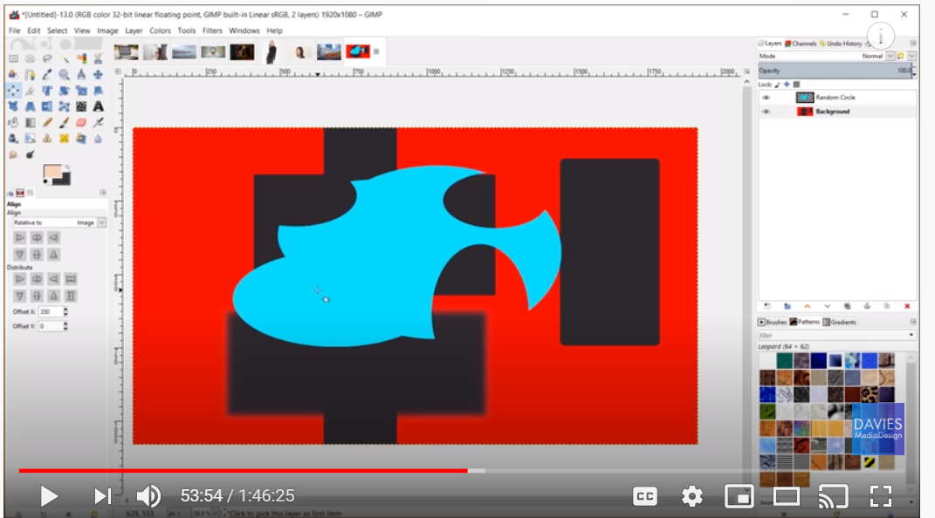
Alignment Tool – Align an object to an Image

Slide 33
Let’s Practice
Start a new Document
File > New
Set height and width – Inches (needed for print) vs Pixels
1920w x 1080h px
Set the background color
Where to get free images:
https://pixabay.com/

Slide 34
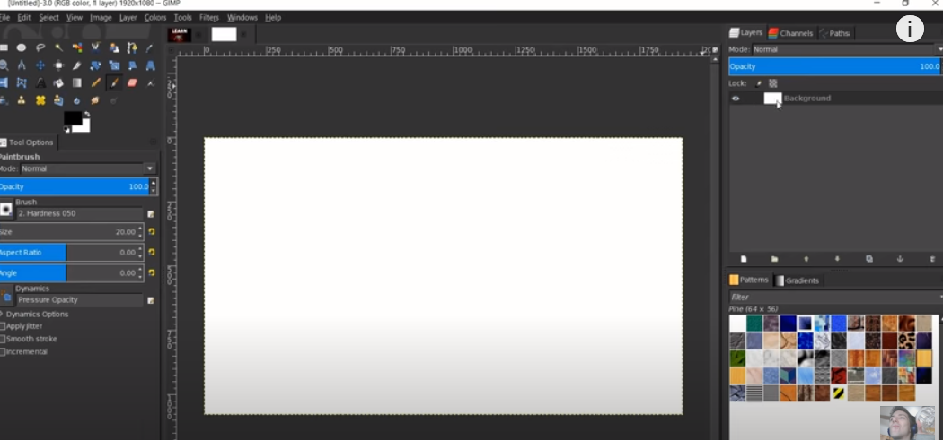
Result:

Slide 35
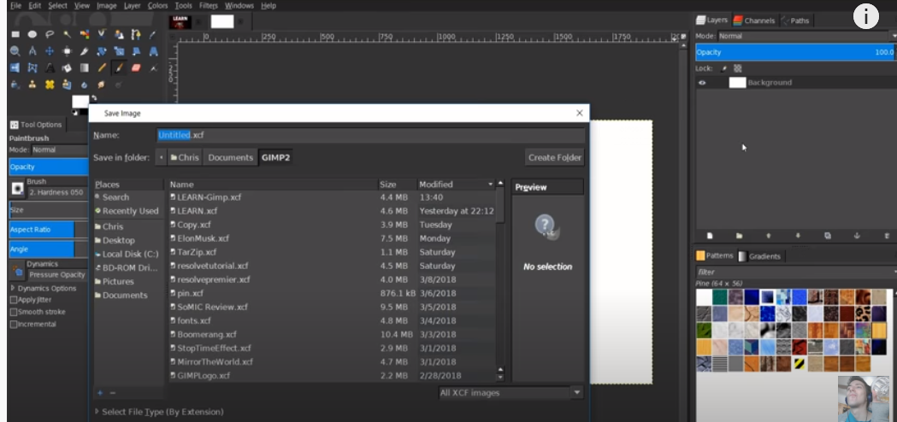
File -> Save As (.xcf)

Slide 36
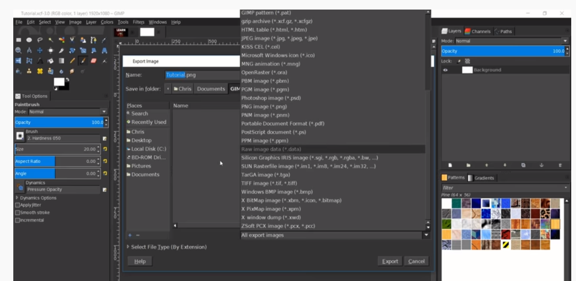
Export Images

Slide 37
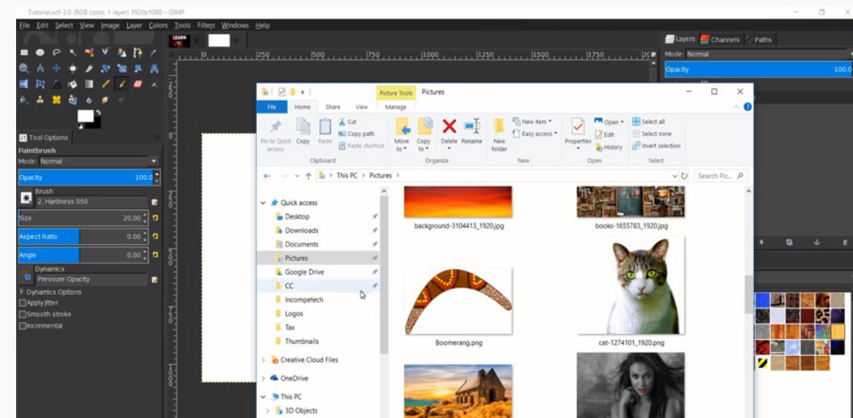
Practice – Import a files (drag an image in)

Slide 38
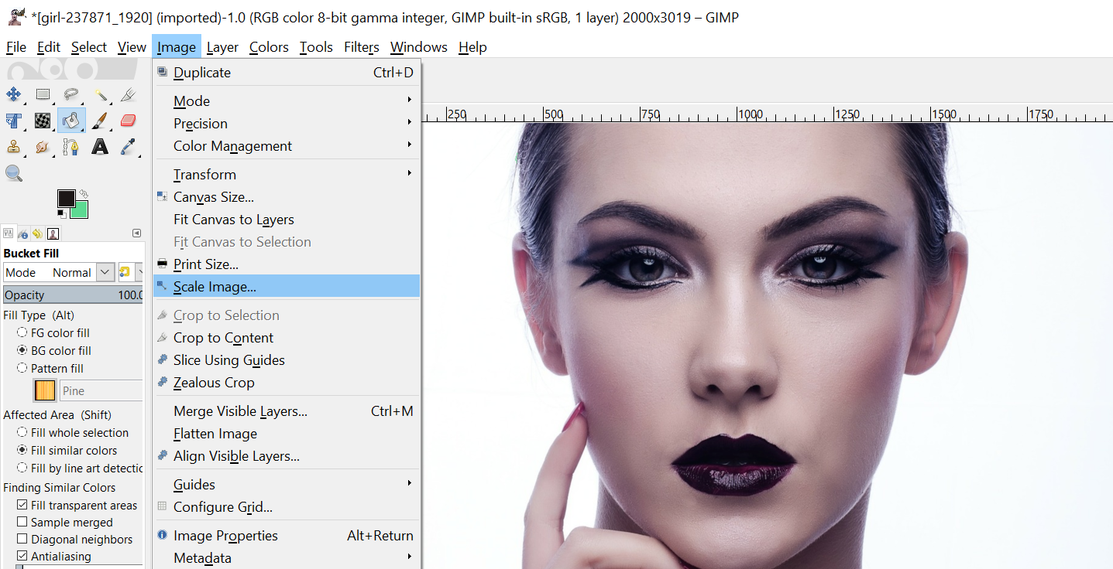
Change Image Size

Slide 39
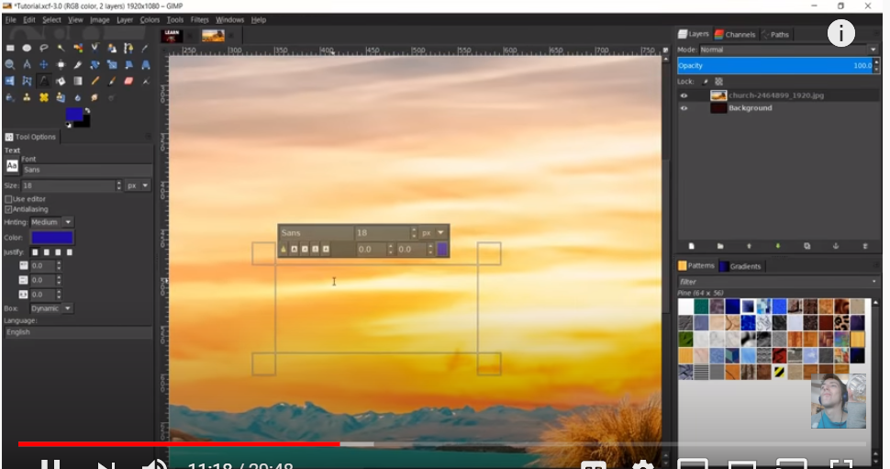
Add Text to an Image – Text Tool

Slide 40
More Learning:
GIMP and Layers
https://www.youtube.com/watch?v=pCyBF0NwIDU
GIMP – 10 Tutorials for Beginners
https://i.ytimg.com/an_webp/ADvUgeOm0E4/mqdefault_6s.webp?du=3000&sqp=CL6j5_cF&rs=AOn4CLB3z96MJyd8e4cXEBbfhVNStrTmQA
GIMP Tutorial – Top 5 Enhancing Techniques
https://www.youtube.com/watch?v=TiavEWDVQGE

